Slide 1
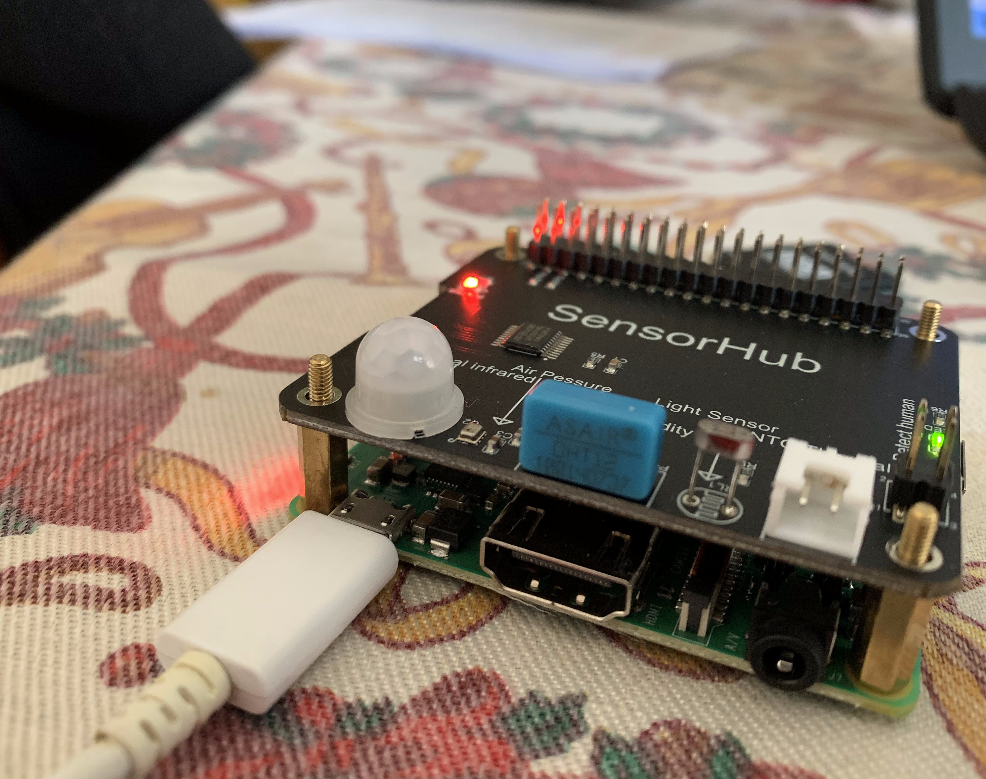
cloudmind4home: a multicloud connected device
Simone Romano
s.romano1992@gmail.com

Slide 2

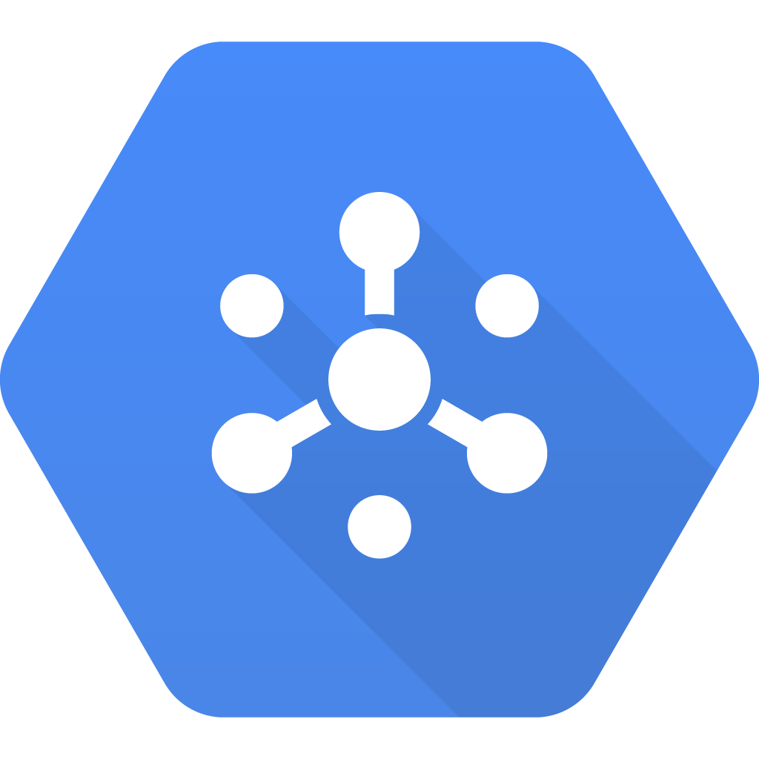

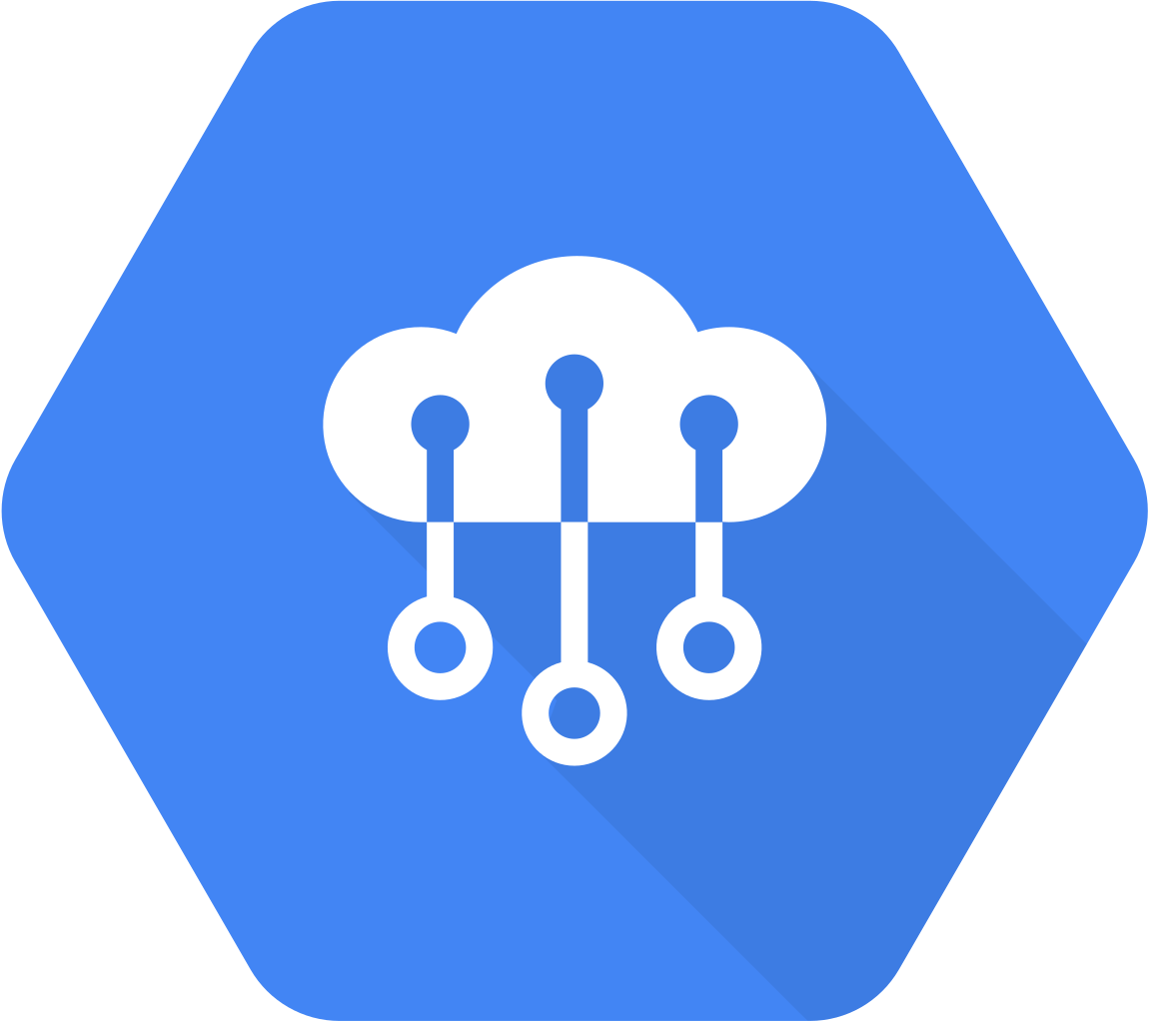
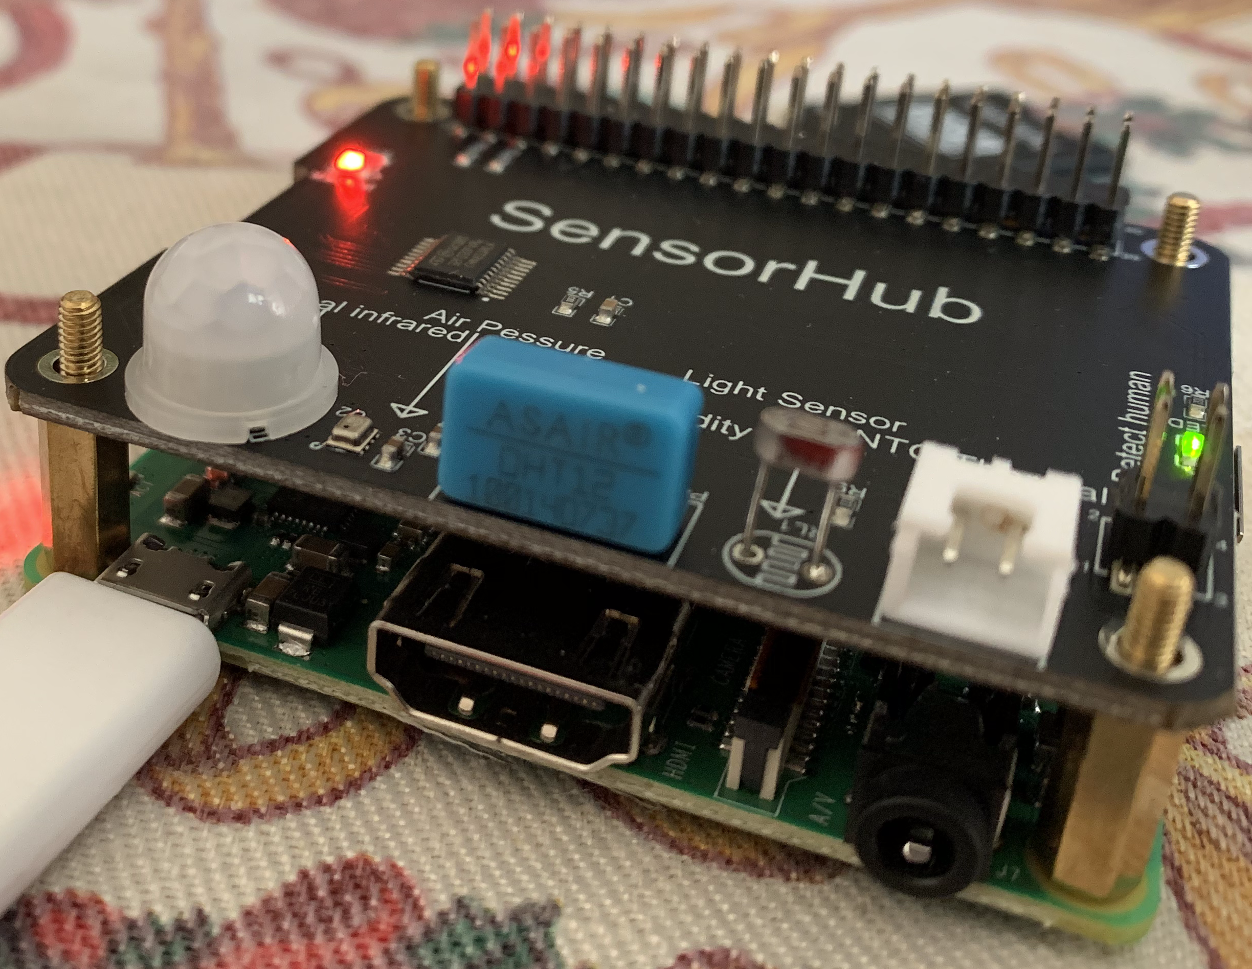




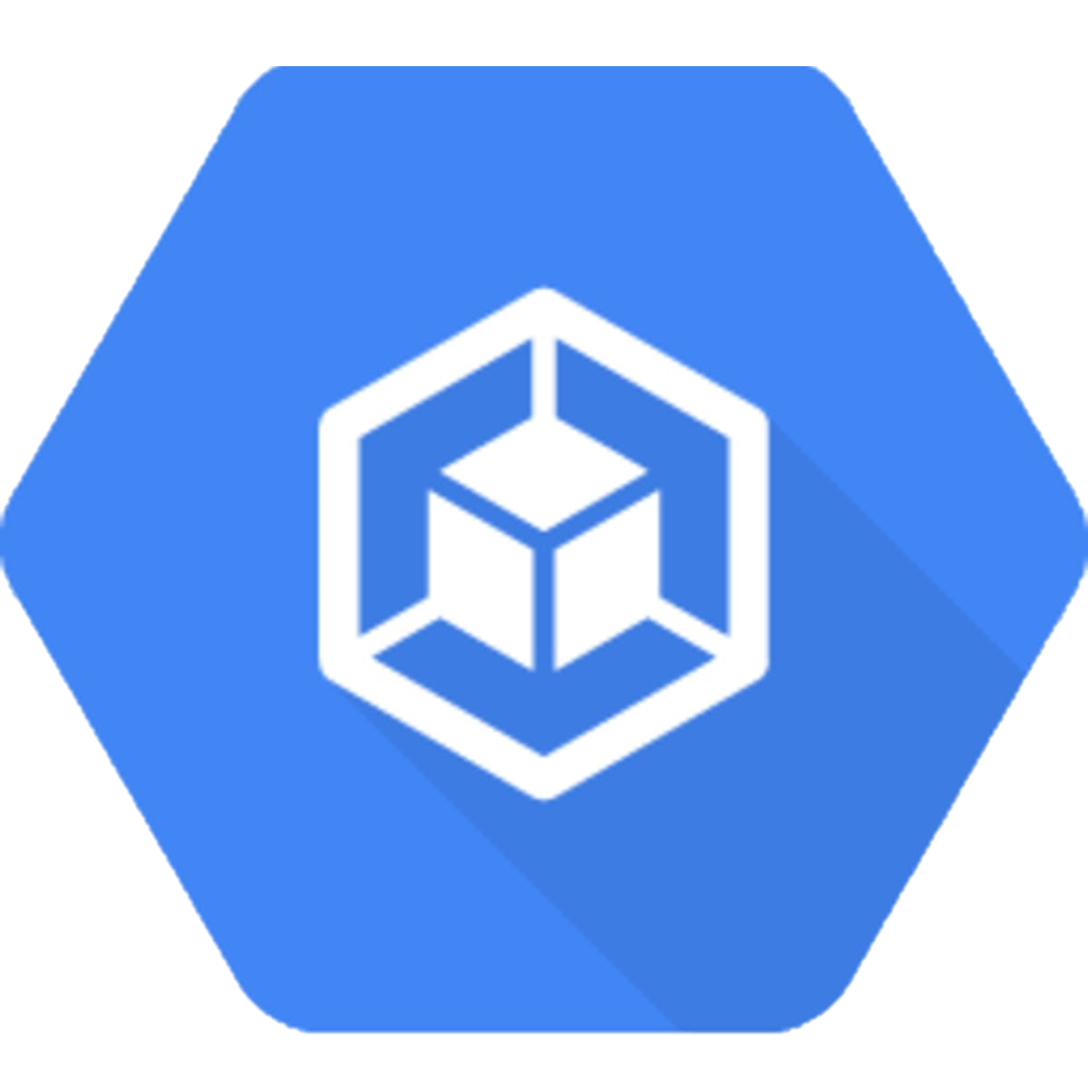

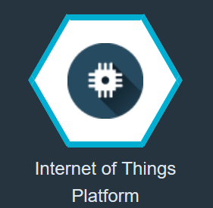
Architecture
CLOUD
HOME NETWORK
Pub Sub
MQTT topic
telemetry topic
/devices/DEVICE_ID/events
{
"offChipTempValue": 22,
"offChipTempStatus": "OK",
"onboardBrightnessValue": 0,
"onboardBrightnessStatus": "KO",
"onboardBrightnessMessage": “KO",
"onboardTemperatureValue": 24,
"onboardTemperatureStatus": "OK",
"onboardHumidityValue": 49,
"onboardHumidityStatus": "OK",
"barometerTemperaturValue": 25,
"barometerTemperaturStatus": "OK",
"barometerPressureValue": 101012,
"barometerPressureStatus": "OK",
"presenceValue": 0,
"presenceStatus": "OK",
"presenceMessage": "No humans detected!",
"rilevationTime": "07-01-2020 22:29:59.336902",
"imei": "EMULATOR",
"props": []
}
Cloud IoT Core
BigQuery
python firmware
Google Kubernetes engine
sensing()
notifyGoogleCloud()
notifyIBMCloud()
MQTT topic
iot-2/evt/event_id/fmt/format_string
Physical interface – user defined
"presenceValue": 1/0
Logical interface – user defined
MQTT topic
iot-2/type/${typeId}/id/${deviceId}/intf/${logicalInterfaceId}/evt/state
2

